Slide 1

School management system
Dr.Yasser omar

Slide 2

Group members
Mohamed amr 20106990
Mohamed hany 20106887
Ziad amr 20106000
Fady ayman 20106800

Slide 3

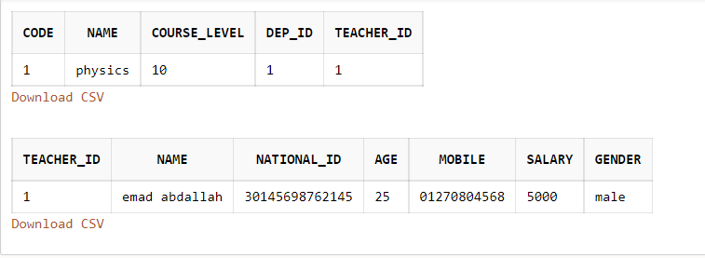
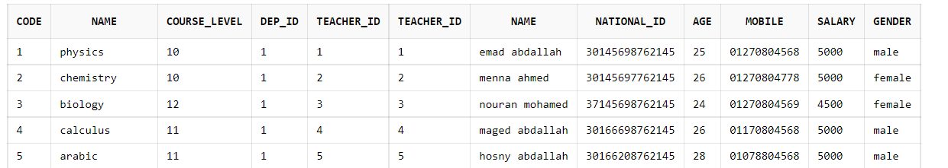
Here we wants to know course information and all information about who is giving that course like the next example
The Result After Our Query

Slide 4
First Query
select * from course inner join teacher ON course.teacher_id = teacher.teacher_id;

Slide 5
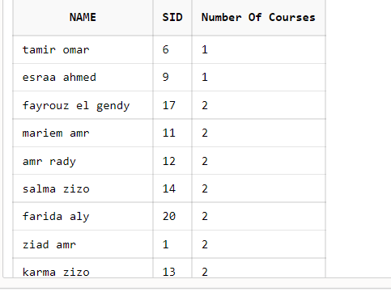
Here we wants to know Student id and student name and number of courses has taken by one student and we ascend that data
The Result After Our Query

Slide 6
Second Query
select name,enrollment.sid,count(code) As "Number Of Courses" from student inner join enrollment on student.sid=enrollment.sid group by enrollment.sid,name order by count(code) asc;

Slide 7
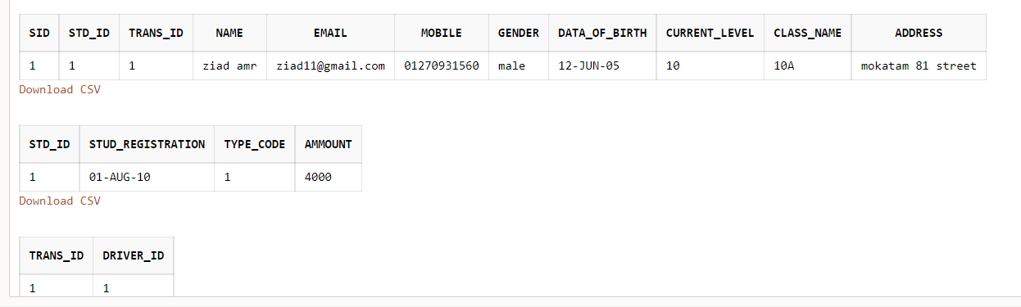
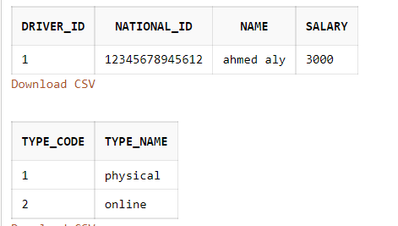
The department employee wants to know student name and current level of student and the driver's name who is responsible for taking student to school and the amount of money that paid for student and the type that he used to register for our school

Slide 8

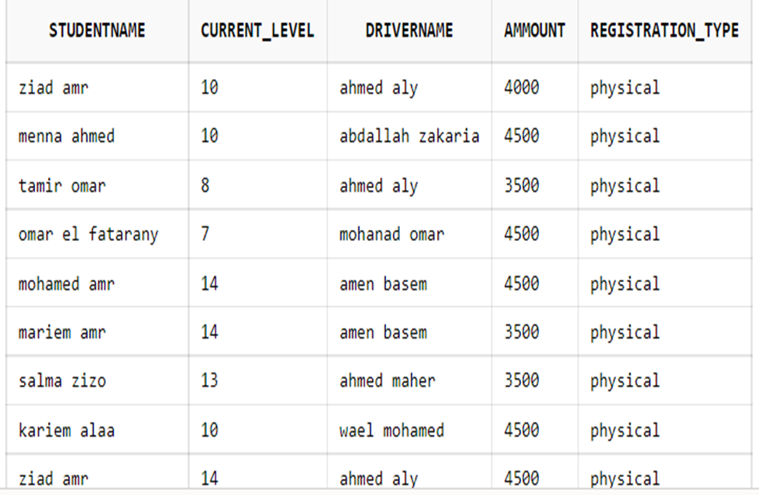
The Result After Our Query

Slide 9
Third Query
select S.name as StudentName,S.CURRENT_LEVEL,D.name As DriverName,SR.ammount,RT.type_name AS Registration_Type
from student S, student_registration SR,transport T,driver D,Rtype RT
where S.sid = SR.std_id
and S.trans_id = T.trans_id
and T.driver_id = D.driver_id
and SR.type_code=RT.type_code;

Slide 10

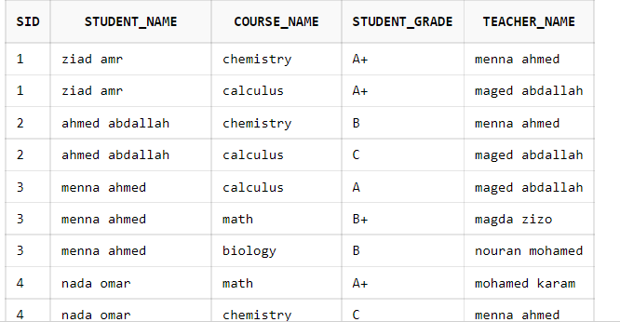
HERE WE WANTS TO KNOW STUDENT NAME AND COURSES HAVE TAKED BY STUDENTS AND GRADES OF THIS COURSES ALSO WHO IS TEACHING THIS COURSE

Slide 11
Forth Query
select S.sid, S.name AS Student_Name ,C.name AS Course_Name, E.grade AS Student_grade ,T.name AS teacher_Name
from enrollment E
inner join student S on E.sid = S.sid
inner join course C on E.code = C.code
inner join teacher T on C.teacher_id = T.teacher_id;

Slide 12
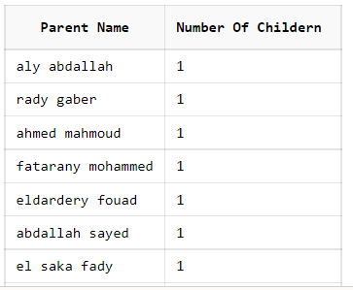
The system must count the number of children of one of the parents

Slide 13
Fifth Query
select name "Parent Name", count(sid) AS "Number Of Childern "
from parent group by name;

Slide 14
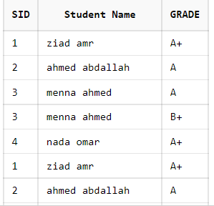
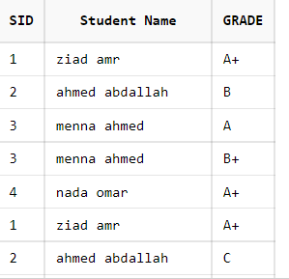
The system must trace the updates that happen to student grade to know is he deserving or someone trying to cheat student grades
AS WE SEE STUDENT NUMBER 2 CHANGER FROM GRADES (B AND C) TO GRADE (A)

Slide 15
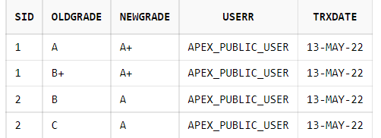
SO, WE HAVE MADE TRIGGERS TO KNOW THE OLD GRADES AND THE NEW ONE ALSE TO KNOW WHO WAS CHANGING IT

Slide 16
Trigger
create table auditGrade (sid number, oldgrade varchar2(10) , newgrade varchar2(10) , userr varchar2(40) , trxdate date)
create or replace trigger lockGrade before update of grade on enrollment
for each row
declare
begin
insert into auditGrade(sid,oldgrade,newgrade,userr,trxdate)
values(:new.sid,:old.grade,:new.grade,user,sysdate);
end;
update enrollment set grade='A+' where sid=1;
select * from auditGrade;

Slide 17
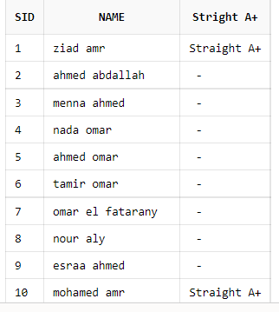
The admission wants to know the students who got Straight A+ for making discount

Slide 18
create or replace function ChkStraightA(p_sid number)
return varchar2
is
v_count number;
begin
select count(*)
into v_count
from enrollment
where sid=p_sid
and grade <> 'A+';
if v_count =0
then return 'Straight A+';
else return NULL;
end if;
end;
select sid,name,ChkStraightA(sid) AS "Stright A+" from student;

Slide 19

Thank you

